Slide 1


An introduction to the eagle-i consortium
Melissa Haendel, Ph.D.
Carlo Torniai, Ph.D
March 2010, OBI workshop
www.eagle-i.org/home
c o n s o r t i u m

Slide 2
What is eagle-i?
NIH funded 2-year pilot project with the goal of improving biomedical research by:
Helping researchers find scientific resources more easily
Reducing time-consuming and expensive duplication of resources
Accelerating the development of diagnostics, treatments, and prevention strategies
Changing the way researchers find resources
c o n s o r t i u m

Slide 3
eagle-i will inventory “invisible” resources
Research generates many resources that are rarely shared or published:
Reagents, protocols, services, instruments, organisms, training opportunities, software, human study metadata, biological specimens, etc.

Slide 4









Participating institutions
Dartmouth College (NH) – Jason H. Moore, PhD
Harvard University (MA) – Lee Nadler, MD; Douglas MacFadden, MS
Jackson State University (MS) – James L. Perkins, PhD
Morehouse School of Medicine (GA) – Gary H. Gibbons, MD
Montana State University (MT) – Sara L. Young, MEd
Oregon Health and Science University (OR) – David W. Robinson, PhD; Chris Shaffer, MS, AHIP
University of Alaska Fairbanks (AK) – Gerald V. Mohatt, MS, EdD***
University of Hawaii Manoa (HI) – Richard Yanagihara, MD
University of Puerto Rico (PR) – Emma Fernandez-Repollet, PhD; José Condé, MD, MPH
***In memoriam
c o n s o r t i u m

Slide 5
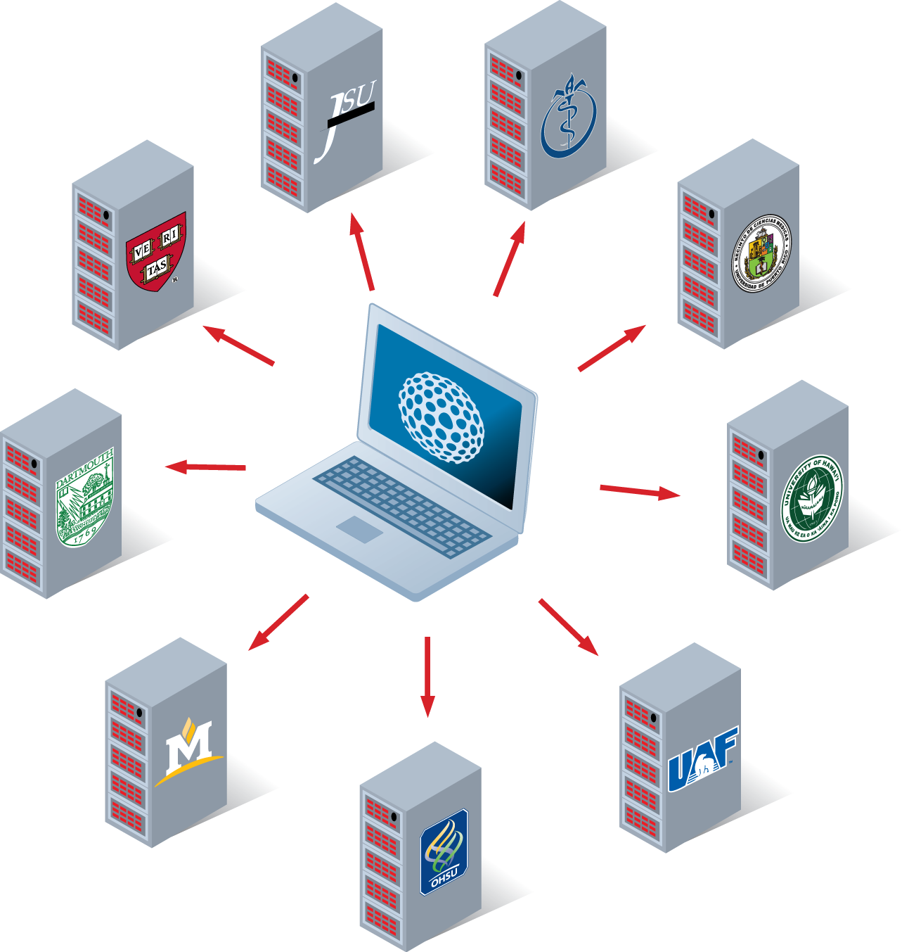
Network architecture
Separate repository for each institution
Networked repositories will be connected via a web-based search portal
Designed for additional institutions to join after the pilot
During the pilot, only participating institutions will have access
c o n s o r t i u m

Slide 6
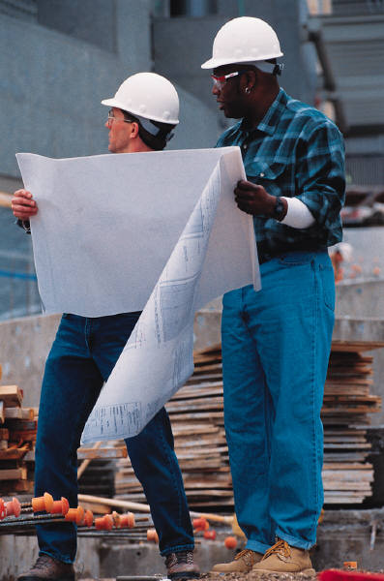


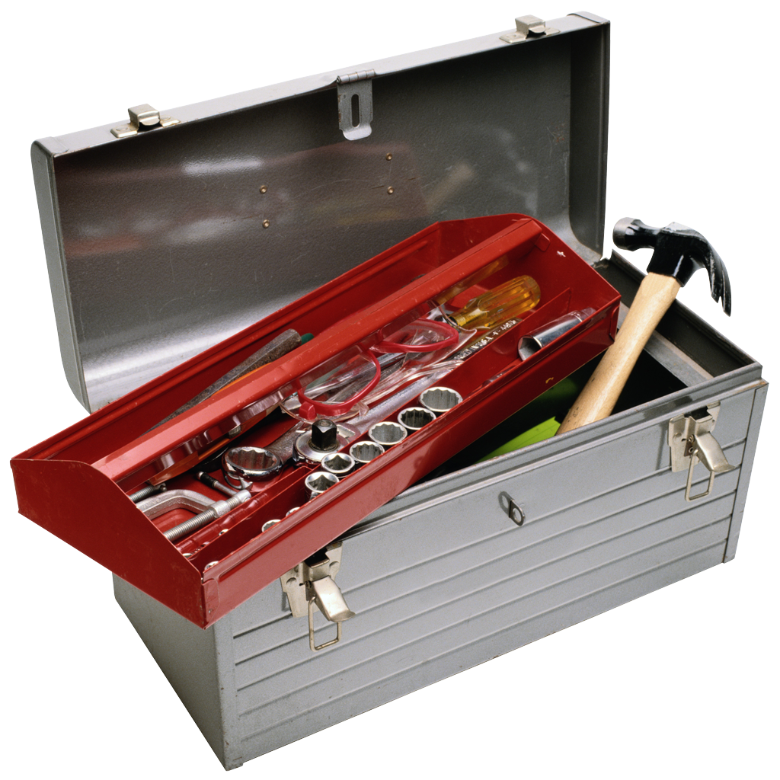
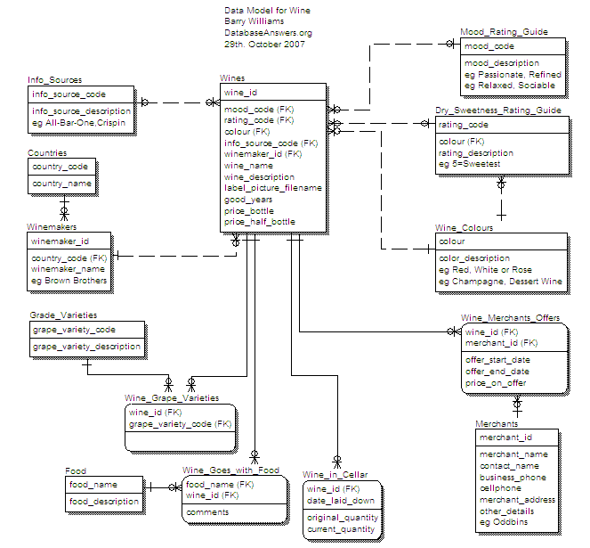

Project roles
OHSU Curation team
Architecture team
Resource Navigator
Data model,
ontologies
Interfaces,
database, and architecture
Resource discovery
Annotation tool
Database
User
Query interface
c o n s o r t i u m

Slide 7

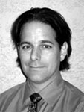
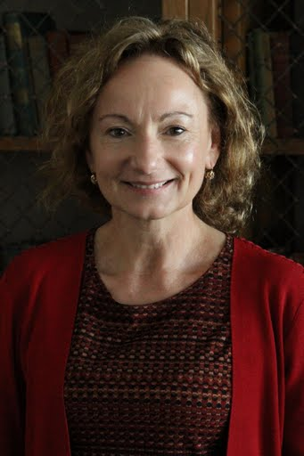

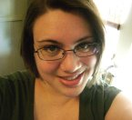
Curation team
Karen Corday
Chris Shaffer
eagle-i co-PI
Melanie Wilson
Erik Segerdell
Tenille Johnson
c o n s o r t i u m

Slide 8
Diverse use cases require diverse ontologies and data sources
For each resource type, eagle-i will assess whether value can be added by leveraging:
existing ontologies for biomedical resources
existing public resource repositories
Community ontologies
and taxonomies
Public repositories and
institutional records
Data inventoried by eagle-i
eagle-i ontologies
repository
c o n s o r t i u m

Slide 9

Vivo: Enabling National Networking of Scientists
The “other” Recovery Act funded project - goal is to establish national networking of scientists
Vivo is based on work done previously at Cornell University
Focus on people, publications and area of expertise
c o n s o r t i u m

Slide 10
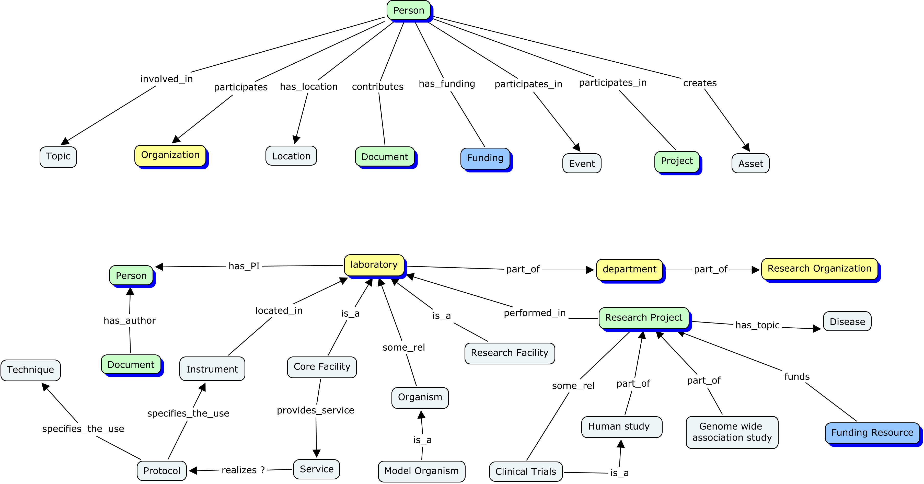
Coordinating eagle-i and Vivo ontologies
Vivo
eagle-i
c o n s o r t i u m

Slide 11
Resource Representation Working Group
Representatives from OBI, BRO, biositemaps, NIF, Vivo and eagle-i (others welcome!)
Work together to reuse, expand, and make interoperable existing ontologies
Google group and listserve
http://groups.google.com/group/resource-representation-coordination
Biweekly online meeting, demos of software, and branch-specific discussions planned
Use of ontology software, techniques to import terms across ontologies
c o n s o r t i u m

Slide 12
eagle-I data model design
Define the conceptual model
Identify resource classes (as per grant RFA)
Identify related classes and relations
Test and define classes and relations based on use case queries
Implement the conceptual model
Explore how existing ontologies can be used to describe classes and relations
Formalize the conceptual schema in OWL, MIREOTing relevant classes from external ontologies
Deploy the OWL file
Use application OWL file to indicate which fields are specified in the search interface and annotation tool
Use for logical inference in the repository
c o n s o r t i u m

Slide 13
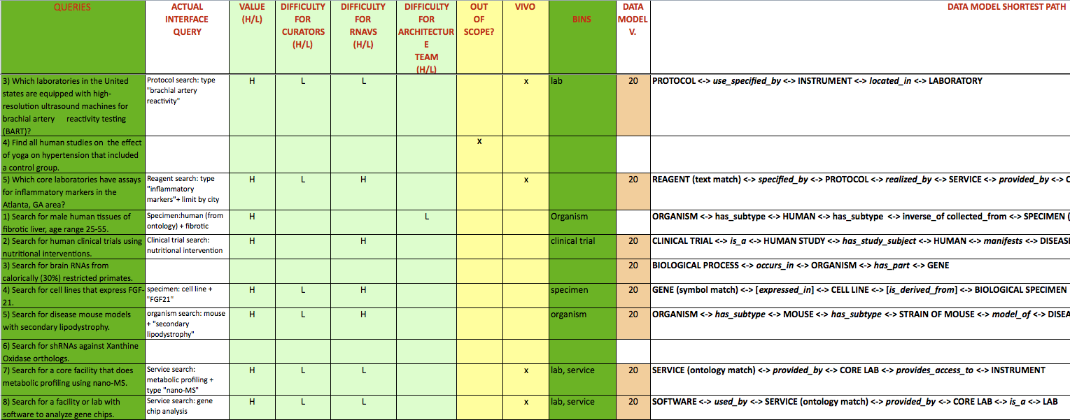
Queries drive the data modeling
Set of queries collected from Resource Navigators
Analyzed and classified according to the value for the project scope
c o n s o r t i u m

Slide 14
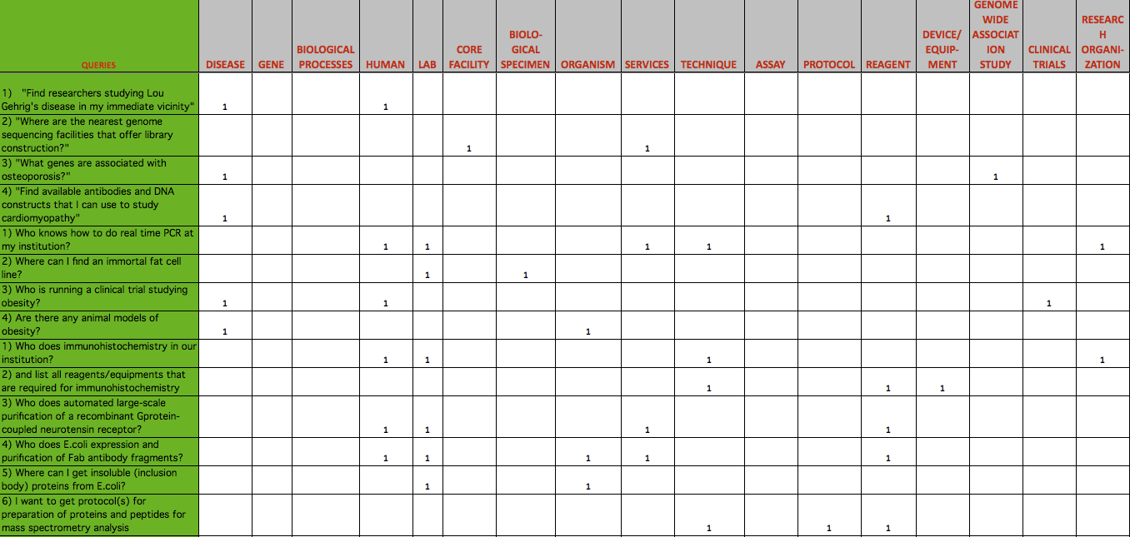
Queries drive the data modeling
40 queries validated against to the data model
80 additional queries in the queue
Every query spans between 2 and 5 classes
c o n s o r t i u m

Slide 15
Queries drive the data modeling
Which laboratories in the United states have high-resolution ultrasound machines for brachial artery reactivity testing (BART)?
PROTOCOL <-> specifies_use_of <-> INSTRUMENT <-> located_in <-> LABORATORY*
Are there any research projects on HPV infection in Oregon?
DISEASE <-> is_study_subject_of <-> RESEARCH PROJECT <-> performed_by <-> LABORATORY* (limit by state)
Find available antibodies used to study cardiomyopathy
REAGENT <-> has_subtype <-> ANTIBODY <-> recognizes_product_of <-> GENE <-> plays_role_in <-> DISEASE
*are these the same type? Probably not.
c o n s o r t i u m

Slide 16
MIREOTing
449 terms MIREOTed so far
For the future
Extending imports for NCBI Taxonomy
Imports from Chebi (reagents), Disease Ontology, GO
Including MeSH terms
c o n s o r t i u m

Slide 17
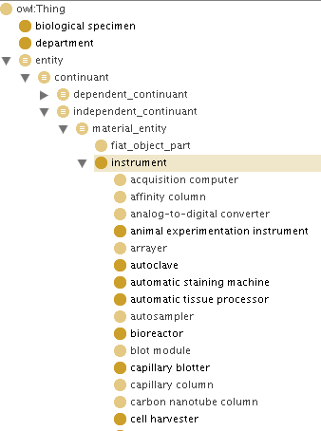
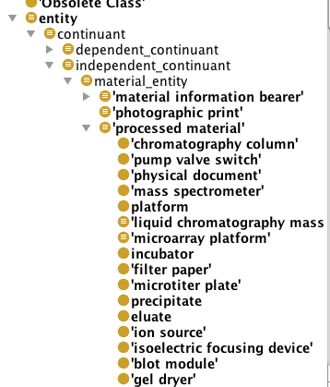
Example MIREOT from OBI
eagle-i
OBI
is_a
Some children of ‘processed material’ were imported under our ‘instrument’ class
c o n s o r t i u m

Slide 18
More information at:
http://purl.obolibrary.org/obo/ero.owl
https://code.google.com/p/eagle-i/
Special thanks to Melanie and Alan, for all their help with purl and MIREOT, among other things
c o n s o r t i u m

